Slide 1
C++
Variables

Slide 2
Today we will look at
Syntax
Comments
Data types

Slide 3
Syntax
Semicolon is the statement terminator – one logical entity
Block is a set of logically connected statements that are surrounded by opening and closing braces
A C++ identifier is a name used to identify a variable, function, class, module, or any other user-defined item. An identifier starts with a letter A to Z or a to z or an underscore (_) followed by zero or more letters, underscores, and digits (0 to 9)
C++ is a case-sensitive programming language. Thus, Manpower and manpower are two different identifiers in C++.

Slide 4
Syntax
Reserved words in c++ can not be used as a variable or constant or any other identifier name.
E.g. else, new, this, throw, for, if, char, false, return, etc …
Trigraphs - A trigraph is a three-character sequence that represents a single character and the sequence always starts with two question marks. E.g. ??( is represents [ … this is for keyboards that don’t have the [ character

Slide 5
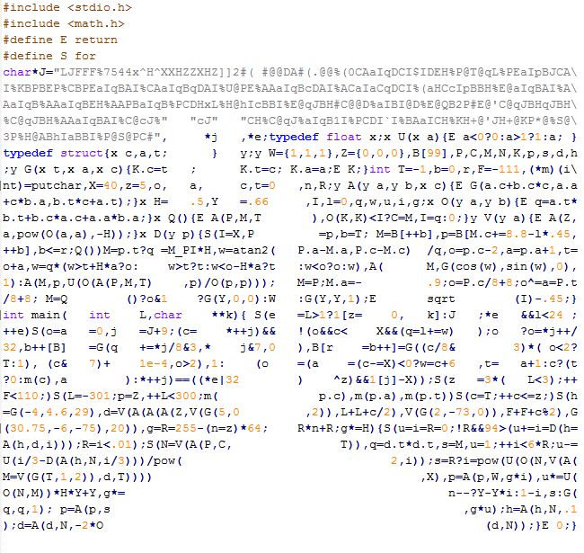
Syntax
Whitespace is blanks (spaces), tabs, newline and comments
This is a ray tracer ->

Slide 6
Comments
/* This is a comment */
/* C++ comments can also
* span multiple lines
*/
int i = /* comment */ 1;

Slide 7
Data types
Every variable has a type
Represents the data that can be stored in it
Informs the compiler how much memory to set aside for it
Informs the compiler what operations can be performed on it

Slide 8
Data Type | Size in Bytes | Range
int | 4 | -2,147,483,648 to 2,147,483,647
char | 1 | -127 to 127 or 0 to 255
bool | 1 | 0 to 1
float | 4 | +/- 3.4e +/- 38 (~7 digits)
double | 8 | +/- 1.7e +/- 308 (~15 digits)

Slide 9

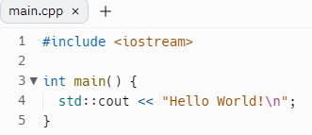

Slide 10
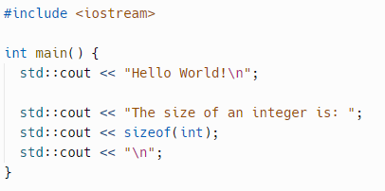


Slide 11
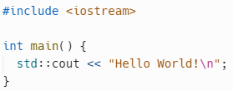
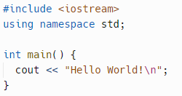

Slide 12
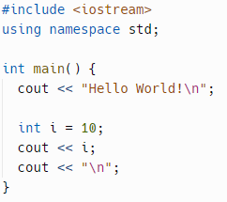


Slide 13
Create a program
Investigate types and datatype modifiers
Measure how much memory each use
Sizeof
Investigate what happens if you go past the bounds of the data type
Int -2,147,483,648 to 2,147,483,647
int i = 2147483647;
i += 10 ??

